Slide 1
Screening, Brief Intervention, Referral to Treatment (SBIRT)

Slide 2
Disclaimer
The content found in this presentation or CEU is for informational purposes only. The content is not meant as a substitute for medical, clinical, legal, or professional advice on any subject matter. New Directions makes every effort to present complete and accurate information, New Directions does not warrant or represent that accuracy, completeness or timelines of such information

Slide 3
Agenda
What is SBIRT?
Why implement SBIRT?
Workflow components
SBIRT for adolescents
Implementation considerations
Resources

Slide 4
What is SBIRT?
Initially developed to provide universal screening, prevention and early intervention/treatment for individuals who are at risk for alcohol misuse within primary care settings
Comprehensive, integrated, public health approach
Goal to prevent consequences of alcohol and drug use in individuals who do not meet the diagnostic criteria for a substance use disorders (SUD) and help those who are diagnosed with SUD to enter and stay in treatment
https://www.samhsa.gov/sbirt
https://www.samhsa.gov/sites/default/files/sbirtwhitepaper_0.pdf

Slide 5
SBIRT Framework
Screening
  Universal screening to quickly assess use and severity of alcohol and other drugs
Brief Intervention
  Utilizing motivational interviewing to intervene based on severity of substance use
Referral to Treatment
  Providing referrals to specialty care

Slide 6
Consequences of Substance Use
INCREASED RISK FOR
  Injury
  Trauma
  Criminal justice involvement
  Social problems – employment, housing, relationships
  Mental health issues - anxiety, depression
  Absenteeism and accidents in the workplace
  Poor management of medical conditions
Notes:
Short term medical
Changes in appetite/weight and sleep
Cardiovascular issues Blood pressure, heart attack, stroke
Overdose
Long term medical
HIV
Hepatitis
Cancer

Slide 7
Why Implement SBIRT?
According to SAMHSA, SBIRT:
Reduces healthcare costs
  Savings range from $3.81 to $5.60 for each $1.00 spent
  20% fewer ED visits
  37% fewer hospitalizations
  46% fewer arrest
  50% fewer motor vehicle accidents
Decreases severity of drug and alcohol use
SBIRT supports overall wellness
Late stage intervention can be expensive and lead to increase comorbid conditions
https://www.integration.samhsa.gov/sbirt_issue_brief.pdf

Slide 8
SBIRT Reimbursement
https://www.integration.samhsa.gov/sbirt_issue_brief.pdf

Slide 9
SBIRT Components

Slide 10
Universal Screening
Recommended to give to all adult patients age 18 or older, at least once a year
Repeat at various at intervals to assess patient progress
Identifies patients who should who require full screening
Primary care: administered by receptionist via paper form, tablet, or kiosk in the waiting area
Emergency department: administered through verbal interview by nurse during triage
https://www.sbirtoregon.org/sbirt-workflow/

Slide 11
Screening
Administration
Check in
Rooming
In advance of appointment
Common assessments
Alcohol Use Disorder Identification Test (AUDIT)
Drug Abuse Screening Test (DAST)NIDA-Modified ASSIST
CAGE
CRAFFT (adolescents)

Slide 12
Full Screening
Administer to adult patients who screened positive
on brief screening
Primary care
  Administered by the medical assistant via paper form or verbal interview in the exam room
Emergency department
  Administered by the behavioral health professional via paper form or verbal interview, before discharge

Slide 13
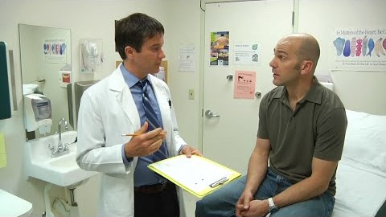
Clinic Workflow - Screening

Slide 14
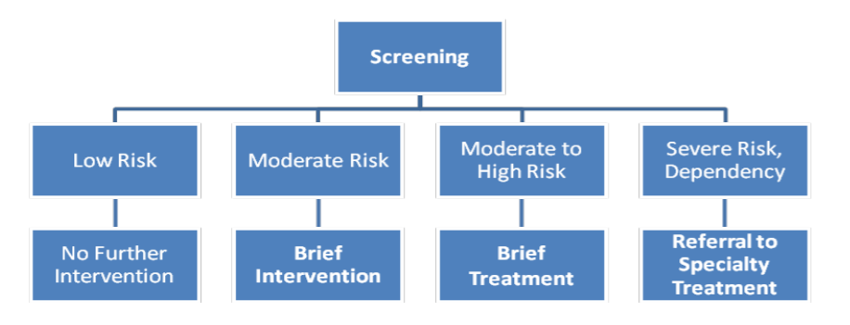
SBIRT Pathway
SAMHSA. (2011) Screening, Brief, Intervention and Referral to Treatment (SBIRT) in Behavioral Healthcare. Retrieved from https://www.samhsa.gov/sites/default/files/sbirtwhitepaper_0.pdf

Slide 15
Brief Intervention
Percentage of patients requiring intervention or treatment can range from 5-20%
Brief intervention - educate and increase motivation to reduce risk behaviors
  Usually 1-5 sessions lasting 15-20 minutes
  15% of patients receive a score indicating need for brief intervention
Brief treatment - change the immediate behavior/thoughts about risky behaviors
  Usually 5-12 sessions lasting 5-20 minutes
  3% of patients receive a score indicating need for brief treatment
SAMHSA. (2011) Screening, Brief, Intervention and Referral to Treatment (SBIRT) in Behavioral Healthcare. Retrieved from https://www.samhsa.gov/sites/default/files/sbirtwhitepaper_0.pdf
Notes:
Frequently implemented by allied health staff such as nurses, social workers, and/or health educators with results/actions documented for physician oversight

Slide 16
Low Risk: Education
Provide feedback on the results
Provide affirmation for healthy choices
and behaviors
Enforce prevention messaging

Slide 17
Risky Behavior: Brief Intervention
Brief intervention - educate and increase motivation to reduce risk behaviors
  Usually 1-5 sessions lasting 15-20 minutes
  15% of patients receive a score indicating need for brief intervention
Brief treatment - change the immediate behavior/thoughts about risky behaviors
  Usually 5-12 sessions lasting 5-20 minutes
  3% of patients receive a score indicating need for brief treatment

Slide 18
Brief Intervention
Evaluate the stage of change
Pre-contemplation
Contemplation
Preparation
Action
Maintenance
Relapse
(Optional)
Termination
https://psychcentral.com/lib/stages-of-change/
https://lightlifelearning.com/facing-addictions-the-stages-of-change/
Notes:
Preparation
Do not intend to take action in the foreseeable future
Often unaware that their problematic behavior or negative consequences
Contemplation
Intend to start the healthy behavior in the foreseeable future
Recognition behavior may be problematic,
More likely to consider pros/cons
Even with recognition, there may still be ambivalence toward behavior change
Preparation (Determination)
Ready to take action within the next 30 days.
Start taking small steps toward the behavior change and believe behavior change can lead to healthier life .
Action
Recently changed and to keep moving forward with the changes.
Maintenance
Sustained behavior change for a while and plan to maintain the changes
Work towards preventing relapse
Termination
No desire to return to unhealthy behaviors and are sure relapse will not occur
This stage rarely reached and most stay in the maintenance stage

Slide 19
Brief Intervention Activates
Build rapport
  Ask permission
  Raise the subject
Discuss pros and cons of continued use
Provide personalized feedback
Evaluate readiness to change
Support action plans and discuss a plan for change
Notes:
Rapport:
I appreciate you answering our health questionnaire. I’d like to take a few minutes to talk about your results. Is that okay with you?
Tell me about a typical day in your life. Where does your current [alcohol/drug] use fit in?
Pros/cons:
Help me understand, through your eyes, the good things about using [alcohol/drugs]?
What are some of the not-so-good things? So, on one hand [PROS] and on the other [CONS]
Feedback:
I have some information on low-risk guidelines for drinking/drug use. Would you mind if I shared them with you?
We know that drinking ________ [amount] . . . and/or using drugs such as __________ . . . can put you at risk for social or legal problems, as well as illness and injury.
It can also cause health problems like [insert relevant medical information].
What are your thoughts on that?
Readiness
This Readiness Ruler is like the Pain Scale we use to rate current pain. On a scale from 1 to 10, with 1 being not ready at all and 10 being completely ready, how ready are you to make any changes in your drinking/drug use?
Why did you choose that number and not a lower one like a 1 or a 2?
On a scale of 1 to 10, how important is it for you to decrease or quit drinking/drug use?
On a scale of 1 to 10, how confident are you that you will be able to make this change?
Plan:
What are some steps/options that will work for you to stay healthy and safe?
What will help you to reduce the things you don’t like about using [alcohol/drugs]?
What supports do you have for making this change?
Tell me about a challenge you overcame in the past.
How can you use those supports/resources to help you now?
Is it okay for me to write down your plan for you to keep as a reminder?
Will you summarize the steps you’ll take to change your alcohol/drug use?
I have some additional resources that people sometimes find helpful.
Would you like to hear about them?
Thank you for talking with me today.

Slide 20
Brief Intervention Activates
Readiness ruler
  On a scale of 1 to 10
OARS – help to engage and lead patients into self-motivational statements
  Open-ended questions
  Affirmations
  Reflective listening
  Summarize
http://www.sbirt.care/tools.aspx
Notes:
Rapport:
I appreciate you answering our health questionnaire. I’d like to take a few minutes to talk about your results. Is that okay with you?
Tell me about a typical day in your life. Where does your current [alcohol/drug] use fit in?
Pros/cons:
Help me understand, through your eyes, the good things about using [alcohol/drugs]?
What are some of the not-so-good things? So, on one hand [PROS] and on the other [CONS]
Feedback:
I have some information on low-risk guidelines for drinking/drug use. Would you mind if I shared them with you?
We know that drinking ________ [amount] . . . and/or using drugs such as __________ . . . can put you at risk for social or legal problems, as well as illness and injury.
It can also cause health problems like [insert relevant medical information].
What are your thoughts on that?
Readiness
This Readiness Ruler is like the Pain Scale we use to rate current pain. On a scale from 1 to 10, with 1 being not ready at all and 10 being completely ready, how ready are you to make any changes in your drinking/drug use?
Why did you choose that number and not a lower one like a 1 or a 2?
On a scale of 1 to 10, how important is it for you to decrease or quit drinking/drug use?
On a scale of 1 to 10, how confident are you that you will be able to make this change?
Plan:
What are some steps/options that will work for you to stay healthy and safe?
What will help you to reduce the things you don’t like about using [alcohol/drugs]?
What supports do you have for making this change?
Tell me about a challenge you overcame in the past.
How can you use those supports/resources to help you now?
Is it okay for me to write down your plan for you to keep as a reminder?
Will you summarize the steps you’ll take to change your alcohol/drug use?
I have some additional resources that people sometimes find helpful.
Would you like to hear about them?
Thank you for talking with me today.

Slide 21
Brief Intervention Activates
Evoke change talk: DARN CAT
Desire
A wanting, wishing or willing.
  Do not express specific reasons only a general level of desire
Ability
Personal perceptions of capability or possibility to change
Reasons
Specifies a particular rationale, justification or motivation for making change
Needs
Necessity, urgency or requirement for change
Commitment
Agreement or intention to change target behavior
Activation
Steps toward change
Taking steps
A particular action taken that moves toward the change
Notes:
DARN = preparatory change talk
Desire
I want, I wish, I hope
Ability
I can, I am able to, I could do it
Reasons
If I stop drinking than I won’t lose my job
Needs
I need, I must, I can’t keep
CAT = mobilizing change
Commitment
I’m prepared, I’m going to, I swear
Activation
I’m ready to, I plan to
Taking Steps
I got rid of the alcohol in the house

Slide 22
Brief Intervention Activates
Goal setting
  Provide rationale for setting goals
  Elicit desired outcomes
  Be specific about the goal
  State goals in positive manner
  Define behaviors related to goal
Notes:
Rational: if you identify what you want to change, we can take steps to work on that
Outcomes: list the things you want to get out of these appointments
Specifics: what is the target goal and what is the patient’s role
Positive: list some things you want rather than what you don’t want
Define: what does it look when you are using substance vs when you’re not using

Slide 23
Brief Intervention Activates
Identify challenging thoughts with the ABCs
  Antecedents: people, places, feelings, etc. that occur before the behavior
  Behaviors: what behavior occurred as a result of the antecedents
  Consequences: what positives/negatives where the response to the behaviors
Homework
  Readings, behavior monitoring or practicing skills should be given
  Help to facilitate skill acquisition, treatment compliance and symptom reduction

Slide 24
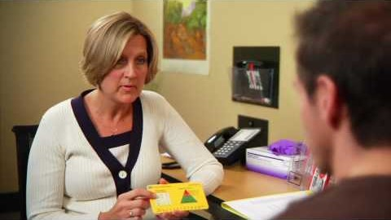
Brief Intervention

Slide 25
Referral to Treatment
Provide feedback and recommendations based upon screening
Explore motivation to engage in specialty care
  Motivational interviewing techniques can increase participation and retention in treatment
  Maintain engagement for those not engaging in treatment
Appropriate linkage to specialty care is critical
  Coordination and continuity of care need to be timely and appropriate
  Warm hand-off is best practice
Help to identify and problem-solve treatment barriers

Slide 26
SBIRT for Adolescents

Slide 27
Why Implement SBIRT with Adolescents
Majority of adolescents have used drugs or alcohol by the time they have reached 12th grade
Drugs and/or alcohol use generally occurs between 7th and 9th grade
By 12th grade:
  80% of high school seniors report having used alcohol
  62% report having gotten drunk
  31% report having episodic use
1
2
3
SAMHSA. (2018). Adolescent Screening, Brief Intervention, Referral to Treatment for Alcohol and Other Drug Use. Retrieved from https://www.integration.samhsa.gov/clinical-practice/sbirt/adolescent_screening,_brieft_intervention_and_referral_to_treatment_for_alcohol.pdf

Slide 28
CRAFFT
Can be utilized for anyone under the age of 21
Screens for both alcohol and drugs
Can be integrated into an electronic health record
Implementation options
  Give the adolescent a paper copy to complete in privacy
  Physician, NP or other provider (nurse, physician assistant, etc.) can questions verbally and document

Slide 29
CRAFFT
Remind adolescent patients to answer honestly and all answers are confidential
Ask pre-screening questions:
  In the past 12 month, did you:
    Drink any alcohol (more than a few sips)
    Use marijuana
    Use anything else to get high (anything else can include illegal drugs, over-the-counter medications, prescription medication or anything that can be sniffed or huffed)
Notes:
If patient answers no to all then ask first question of CRAFFT
If patients yes to any of the questions then ask all CRAFFT questions

Slide 30
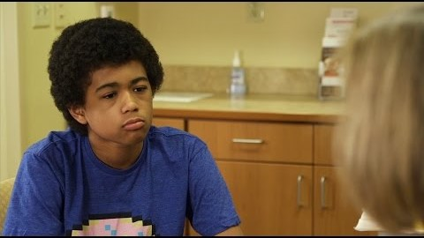
Adolescent Screening

Slide 31
Implementation

Slide 32
Implementation
Develop an implementation team
  Recommend multi-disciplinary team
  Discuss hiring considerations
  Communicate to organization
Identify which screenings
  How will they be administered
  EHR functionality
Create protocols
  Roles/responsibilities for staff
  Frequency of administration
  Response to urgent or life-threatening behaviors
Referral resources
  Client handout
  Develop direct pathways with community providers
Implementation Training

Slide 33
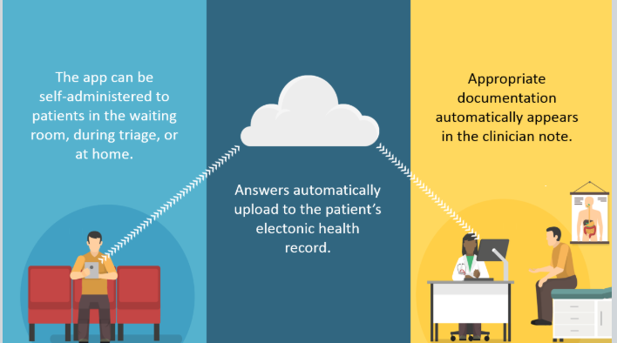
SBIRT App
Web-based app that:
Screens adolescents and adults for substance use and depression
Converts answers into chart-ready notes for the medical professional
Reads questions out loud for patients with low literacy
Streamlines the delivery of multiple screening tools in English or Spanish
Available screenings
ASSIST for adult drug use
AUDIT-C and AUDIT for adult alcohol use
PHQ-2 and PHQ-9 for adult depression
S2BI for adolescent substance use
PHQ-2 and PHQ-9 Modified for Teens for adolescent depression
http://sbirtapp.org/intro

Slide 34
Implementation Best Practices
Practice champion
Utilize an inter-professional team
Align SBIRT with primary care office flow
  Define/communicate within the team of each SBIRT step
Consider using pre-screening instrument
Integrate SBIRT documentation into the EHR
Develop relationship with referral partners
Institute ongoing SBIRT training
Hargraves, D., White, C., Frederick, R., Cinibulk, M., Peters, M., Young, A., & Elder, N. (2017). Implementing SBIRT in primary care: lessons learned from multi-practice evaluation portfolio. Retrieved from https://www.ncbi.nlm.nih.gov/pmc/articles/PMC5809898/

Slide 35
Implementation Considerations
Tracking of screening
Human resources
Policy and procedures
Measuring outcomes
Notes:
Tracking
When patients are due for the screening
Tracking results
Who scores and connects to next steps
HR
Job descriptions – roles and responsibilities
Staff need – potential hiring
Policies
Who scores screening and connects steps
Who provides interventions
How to manage risk patients – suicide, active intoxication, active withdrawal, etc
Outcomes
What to measure
How to define success

Slide 36
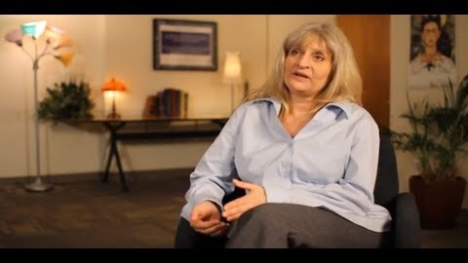
Patient Testimonial

Slide 37
Questions

Slide 38
Appendix

Slide 39
Resources
SBIRT in a Medical Setting
  https://www.sbirtoregon.org/training-curriculum/
Help Patients Who Drink Too Much: Clinical Approach
  https://pubs.niaaa.nih.gov/publications/Practitioner/CliniciansGuide2005/clinicians_guide.htm
Helping Smokers Quit: A Guide for Clinicians
  https://www.ahrq.gov/sites/default/files/wysiwyg/professionals/clinicians-providers/guidelines-recommendations/tobacco/clinicians/references/clinhlpsmkqt/clinhlpsmksqt.pdf
SBIRT Provider Card
  English: http://www.sbirt.care/pdfs/tools/Hard%20Card%20August%202016.PDF
  Spanish: http://www.sbirt.care/pdfs/tools/SBIRT%20Provider%20Card_March%202017_Spanish.pdf
Conducting a referral to treatment
  http://www.sbirt.care/pdfs/tools/Referral%20to%20treatment%20brief%20intervention%207%2023%2017.PDF
A Therapist’s Guide to Brief Cognitive Behavioral Therapy
  https://www.mirecc.va.gov/visn16/docs/therapists_guide_to_brief_cbtmanual.pdf
SBIRT YouTube
  https://www.youtube.com/channel/UC38ME1lH7HnyTZ5OjexrNMw
Screening forms – multiple language downloads
  https://www.sbirtoregon.org/screening-forms/

Slide 40
Resources
Clinic handouts
  https://www.sbirtoregon.org/clinic-tools/
SBIRT for Adolescents
  https://www.youtube.com/watch?v=JtCd4jATtFw&t=1s
Adolescent Screening, Brief Intervention, Referral to Treatment for Alcohol and Other Drug Use
  https://www.integration.samhsa.gov/clinical-practice/sbirt/adolescent_screening,_brieft_intervention_and_referral_to_treatment_for_alcohol.pdf
Alcohol Screening and Brief Intervention for Youth
  https://www.integration.samhsa.gov/clinical-practice/sbirt/Guide_for_Youth_Screening_and_Brief_Intervention.pdf

Slide 41
Screening Tools

Slide 42
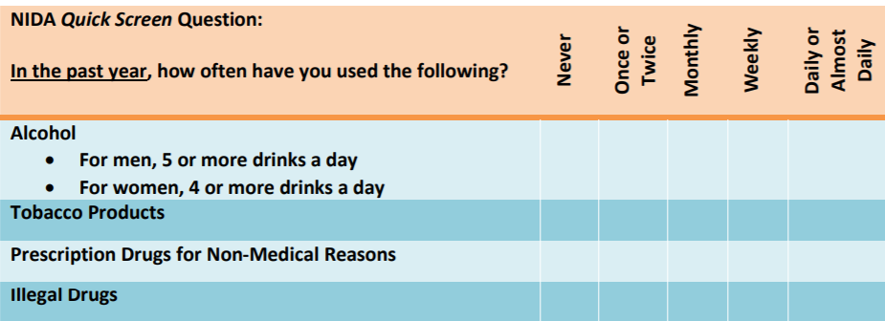
NIDA Quick Screen
https://www.drugabuse.gov/publications/resource-guide-screening-drug-use-in-general-medical-settings/nida-quick-screen
Notes:
If patient says “no” for all drugs - reinforce abstinence and screening complete
If yes to 1+ days heavy drinking – start brief intervention
For healthy men under the age of 65: No more than 4 drinks per day AND no more than 14 drinks per week.
For healthy women under the age of 65 and not pregnant (and healthy men over the age of 65): No more than 3 drinks per day AND no more than 7 drinks per week.
If yes to use of tobacco – advise all to quit
If yes to illegal drugs or prescription drugs for non-medical reasons – proceed to NIDA ASSIST

Slide 43
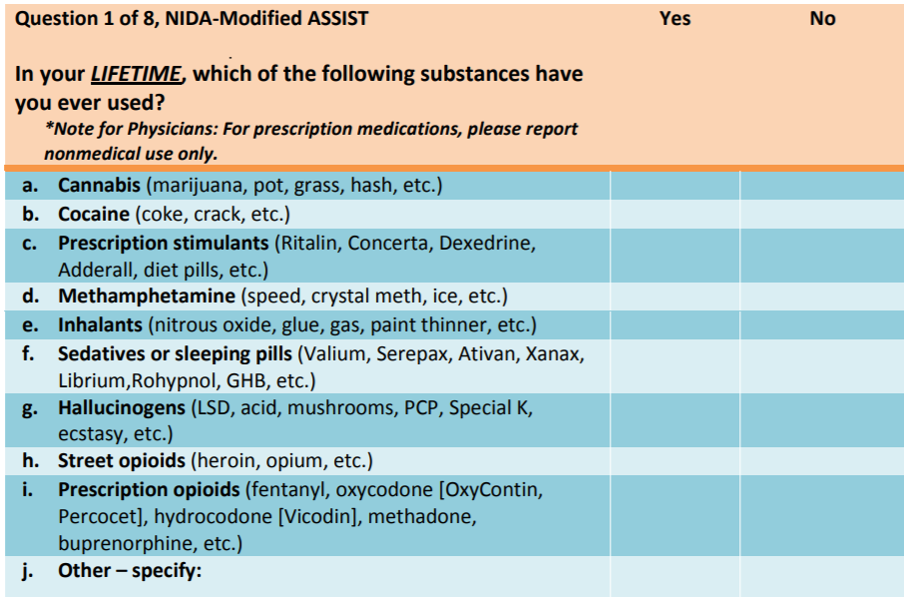
NIDA-Modified ASSIST
https://www.drugabuse.gov/publications/resource-guide-screening-drug-use-in-general-medical-settings/nida-quick-screen
Notes:
If patient answers yes to any of the drugs proceed to questions 2 through 8 to determine level of risk
2 - In the past three months, how often have you used the substances you mentioned
3 - In the past 3 months, how often have you had a strong desire or urge to use
4 - During the past 3 months, how often has your use led to health, social, legal or financial problems?
5 - During the past 3 months, how often have you failed to do what was normally expected of you because of your use
6 - Has a friend or relative or anyone else ever expressed concern about your use
7 - Have you ever tried and failed to control, cut down or stop using
8 - Have you ever used any drug by injection (non-medical use)

Slide 44
NIDA-Modified ASSIST Scoring
https://www.drugabuse.gov/publications/resource-guide-screening-drug-use-in-general-medical-settings/nida-quick-screen
HIGH RISK
Score ≥ 27
Provide feedback on the screening results
Advise, Assess and Assist
Arrange referral
Offer continuing support
MODERATE RISK
Score 4-26
Provide feedback
Advise, Assess and Assist
Consider referral based on
clinical judgement
Offer continuing support
Lower Risk
Score 0-3
Provide feedback
Reinforce abstinence
Offer continuing support

Slide 45
DAST Pre-screening
http://www.sbirt.care/pdfs/tools/DAST.PDF
Notes:
Yes indicates full screening

Slide 46
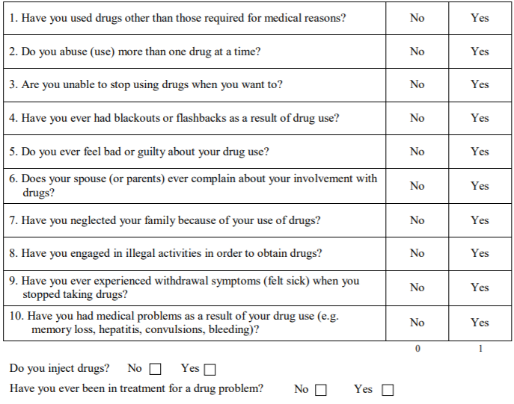
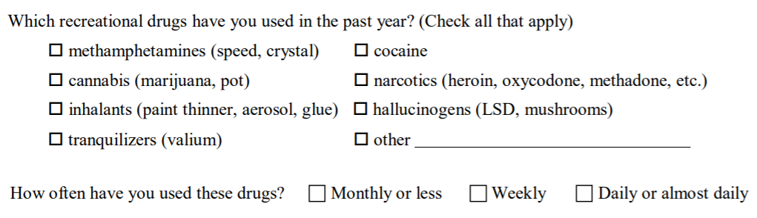
DAST
http://www.cbhallc.com/Documents/Provider%20Guidelines.pdf
Notes:
Yes indicates full screening

Slide 47
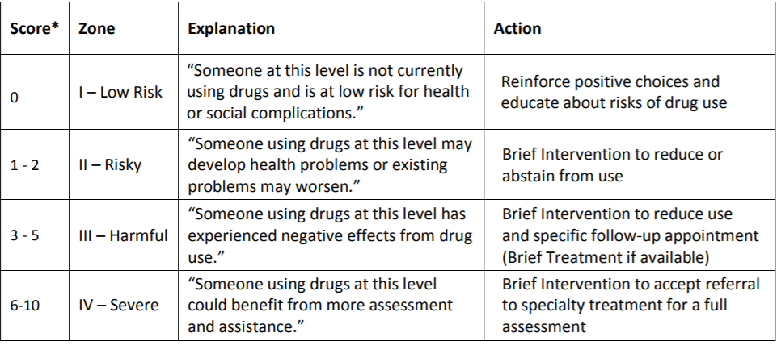
DAST Scoring
http://www.sbirt.care/pdfs/tools/DAST.PDF
Notes:
One point for each yes response
Brief interventions are 5-15 minutes, and should occur in the same session as the initial screening. The recommended behavior change is to decrease or abstain from use
Brief treatment is 1 to 5 sessions, each 15-60 minutes. Refer for brief treatment if available. If brief treatment is not available, secure follow-up in 2-4 weeks
Focus of the brief intervention is to enhance motivation for the patient to accept a referral to specialty treatment

Slide 48
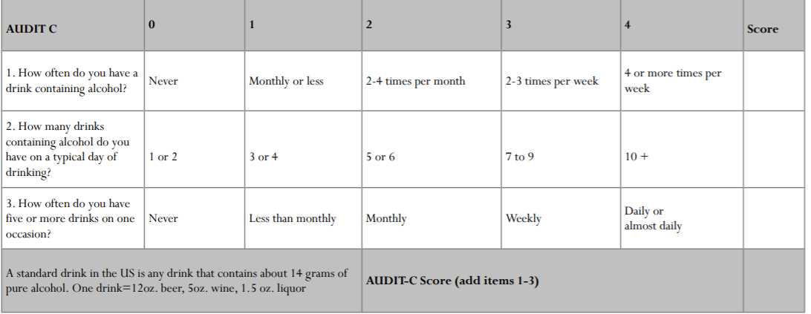
AUDIT Pre-Screen
http://www.cbhallc.com/Documents/Provider%20Guidelines.pdf
Notes:
NEGATIVE SCREEN < 4 for men/ 3 for women – Inform client that they are at low risk. Congratulate clients at low risk and encourage them to remain that way.
POSITIVE SCREEN ≥ 4 for men/ 3 for women - Inform client that they screen positive for hazardous alcohol use and are at risk for health and other problems – continue with the full AUDIT

Slide 49
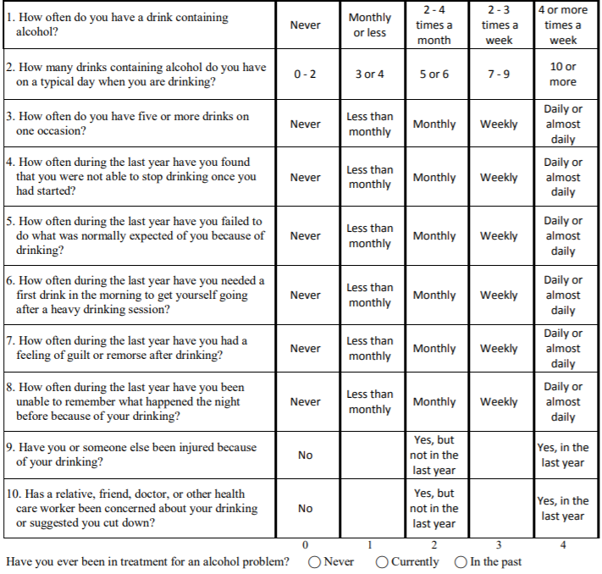
AUDIT
http://www.sbirt.care/pdfs/tools/AUDIT.PDF

Slide 50
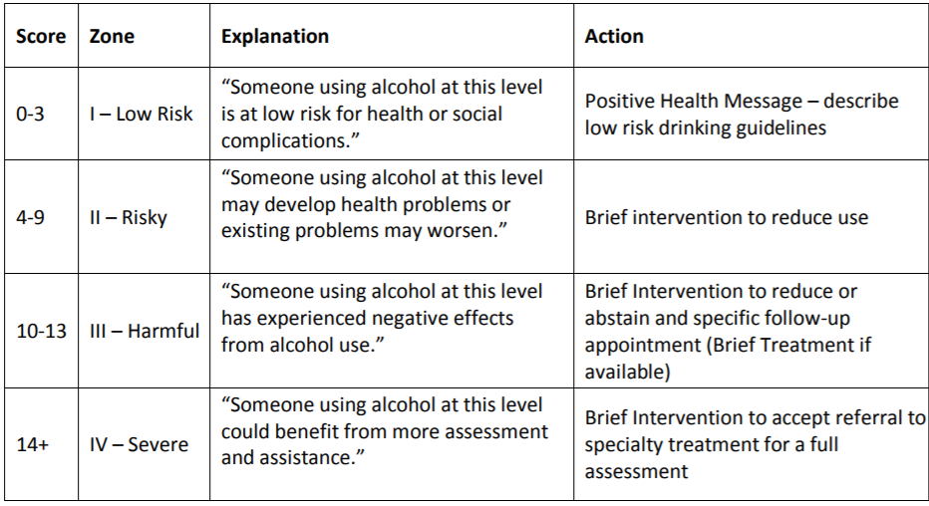
AUDIT Scoring
http://www.sbirt.care/pdfs/tools/AUDIT.PDF

Slide 51
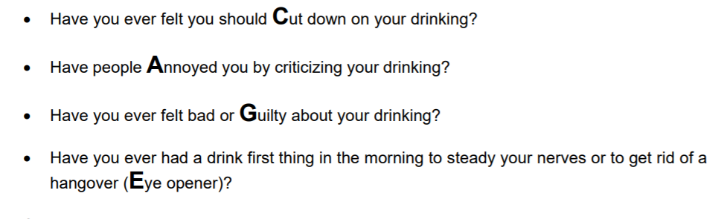
CAGE
https://www.integration.samhsa.gov/clinical-practice/sbirt/CAGE_questionaire.pdf
Notes:
Each yes gets 1 point
Total score of 2 or above indicates need for intervention

Slide 52
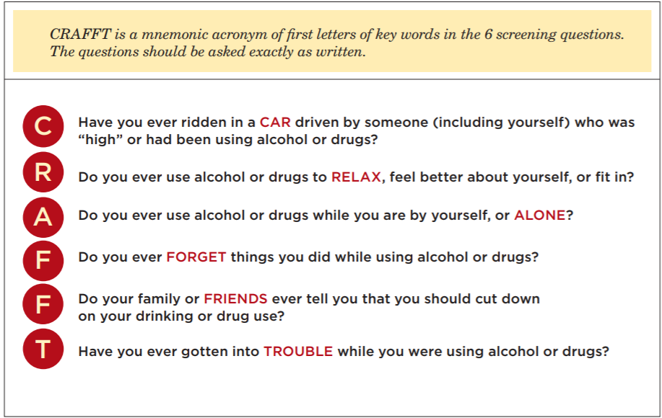
CRAFFT
https://www.integration.samhsa.gov/clinical-practice/sbirt/adolescent_screening,_brieft_intervention_and_referral_to_treatment_for_alcohol.pdf
Notes:
Each yes gets 1 point
Total score of 2 or above indicates need for intervention

Slide 53
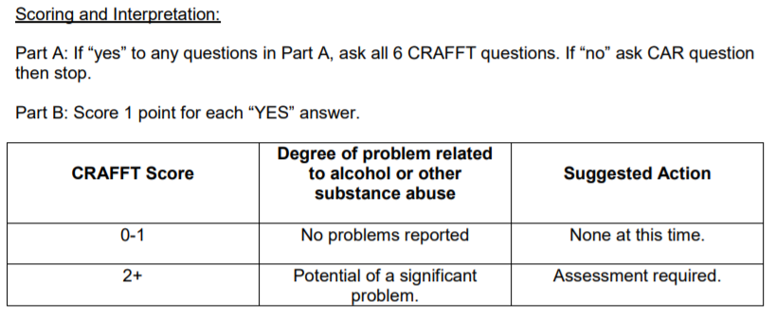
CRAFFT
https://med.dartmouth-hitchcock.org/documents/CRAFFT-adolescent-substance-use-screen.pdf
Notes:
Each yes gets 1 point
Total score of 2 or above indicates need for intervention

